Slide 1

Fuel Consumption of Vehicles
Presented by:-
Deepthi. R
Sahithi. B
Sravani. V

Slide 2

Goal:-
To develop a predictive model for fuel consumption of the vehicles based on the data.
The goal of this data analysis is to develop a predictive model for fuel consumption of vehicles. the focus is on understanding the dataset, selecting appropriate features, and implementing a regression model.
The goal would likely be to build a regression model that accurately predicts fuel consumption using the input features provided in the dataset. Based on the provided dataset columns, here are the general steps you might follow for your machine learning project on predicting fuel consumption.

Slide 3
About:-
The source of our fuel consumption dataset. Was it obtained from Kaggle.
Steps for the Process:
1. Business Understanding
2. Data Understanding and validation
3. EDA & Visualization
4. Modeling
5. Conclusion
Data Information :
The dataset contains information related to fuel consumption and associated factors.
Features/Input Variables :
Model Year, Make, Model, Vehicle Class, Engine Size (L), Cylinders, Transmission, Fuel Type, Fuel Consumption (City) (L/100 km), Fuel Consumption (Hwy) (L/100 km),Fuel Consumption (Comb) (mpg), CO2 Emissions (g/km), CO2 Rating, Smog Rating.
Target/Output Variable :
Fuel Consumption (Comb) (L/100 km)
This is the target variable for our regression task. The goal is to predict the combined fuel consumption based on other features.
This dataset appears to contain a variety of features related to vehicles and their fuel efficiency, making it suitable for predicting fuel consumption based on different attributes of the vehicles.

Slide 4
Business Understanding :
The primary goal of this machine learning project is to predict fuel consumption for vehicles based on various features. The insights derived from the analysis can provide valuable information.
Data Collection :.
The dataset for this machine learning project on fuel consumption consists of information related to various vehicles.
We have two types of sources to collect data:
1.Open Source
2.Web Scraping
For our project, the data collected is from open source.
Dataset Reference:- Kaggle.com
The dataset includes the following columns.
Features/Columns:- Model Year, Make, Model, Vehicle Class, Engine Size (L), Cylinders, Transmission, Fuel Type, Fuel Consumption (City) (L/100 km), Fuel Consumption (Hwy) (L/100 km), Fuel Consumption (Comb) (L/100 km), Fuel Consumption (Comb) (mpg), CO2 Emissions (g/km), CO2 Rating, Smog Rating.

Slide 5

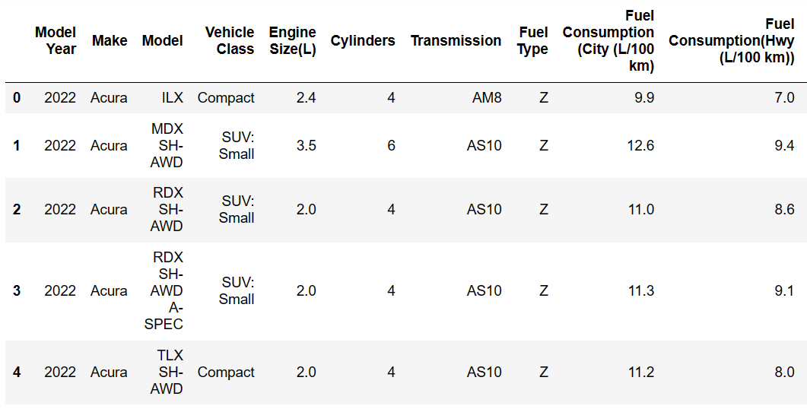
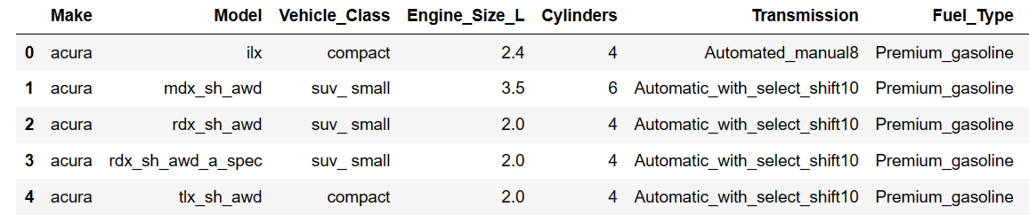
Data Validation & Cleaning:
Basic checks like:
Head and Tail, Shape, Columns, Unique, Features Info, Missing values.
Raw data:-
Here we are taking few columns as a reference.
Make Column: Here I used str.replace(“-’’,”_”)
After:-

Slide 6
Exploratory Data Analysis (EDA) & Visualization:
Conduct exploratory data analysis (EDA) on numerical and categorical features.
Visualize the distribution of fuel consumption and other key variables. And Identify potential correlations between features.
We can get insights on dataset using Exploratory Data Analysis (EDA) methods.
EDA can be of two things they are:-
Statistics
1. Descriptive: We used descriptive statistics.
Visual Analysis
EDA is divided into three types of analysis
Uni-Variate Bi-Variate Multi-Variate
Data study of single column Data study between two columns Data Study b/w three or more columns
Taking important input columns to analysis with reference to the output variable is suggested for analysis.
For this data we have output variable Fuel_Consumption_Comb_L_100_km.
All the Columns are using for analysis

Slide 7
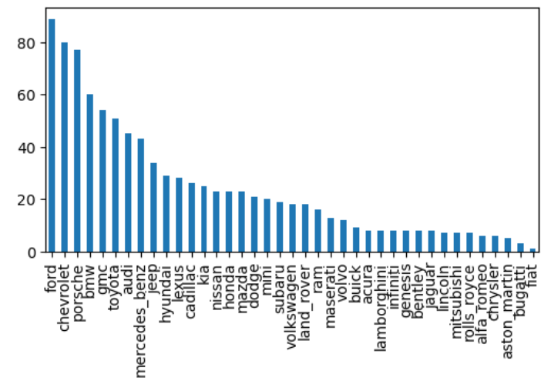
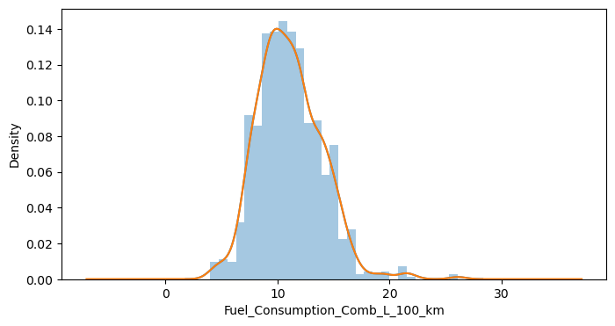
Ui-Variate:-
We are using Uni variate for single column analysis.
For Categorical Analysis
Make column:-
Value Counts of each class: ford
Class Percent: 9.408034
For Numerical Analysis
Fuel_Consumption_Comb_L_100_km Column:-
count 946.000000
mean 11.092072
std 2.876276
min 4.000000
25% 9.100000
50% 10.800000
75% 12.900000
max 26.100000

Slide 8
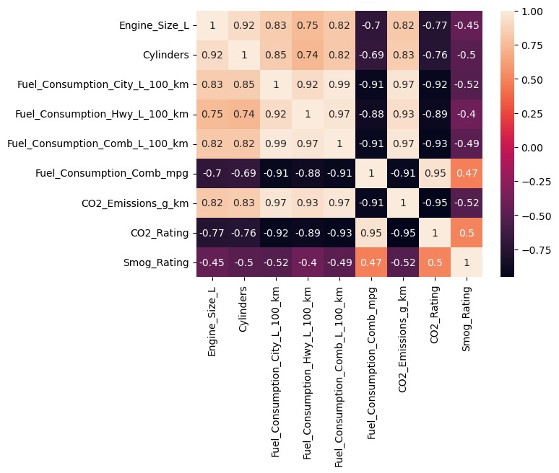
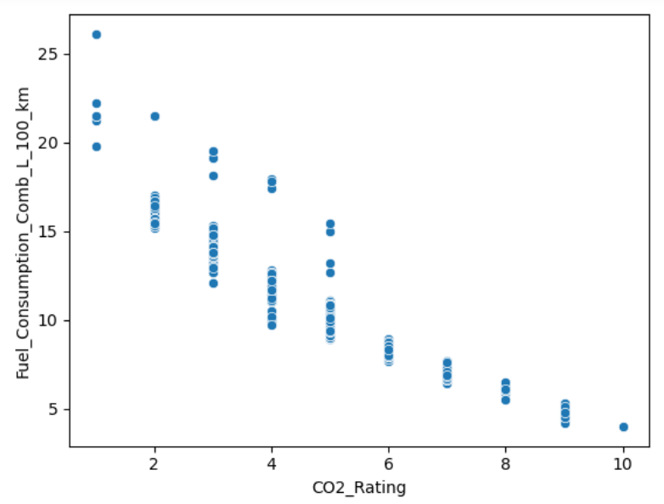
Bi-Variate:- Data study between two columns
The relationships between various attributes such as Engine Size,
Cylinders, different types of Fuel Consumption (City, Highway, Combined),
CO2 Emissions, CO2 Rating, and Smog Rating.
The correlation between Fuel Consumption City (L/100 km) and
CO2 Emissions (g/km) is 0.97 according to the heatmap. This indicates a
very strong positive correlation.
The correlation between Fuel Consumption on the Highway (L/100 km) and Combined Fuel Consumption (L/100 km) is 0.97 according to the heatmap. This indicates a perfect positive correlation.
The correlation between CO2 Rating and Combined Fuel Consumption (L/100 km)
is -0.935 according to the heatmap. This indicates a strong negative correlation.

Slide 9
Over all Insights from data:-
In Fuel_Consumption_Comb_L_100_km Bugatti has highest value.
For CO2_Rating and Fuel_Consumption_Comb_L_100_km have -0.92 negative correlation occur.
Fuel_Consumption_Comb_L_100_km follows normal distribution.
For Fuel_Consumption_City_L_100_km and Fuel_Consumption_Comb_L_100_km have 99% of correlation.
Fuel_type premium_gasoline have highest value counts of 458 with a percentage 48%.
Smog_Rating of a vehicle has 5 rating with a value count of 308 with a percentage of 32%.
For fuel_Consumption_Comb_L_100_km have mean, median and standard deviation values are (11.09, 10.8, 2.87).
Ford has highest value counts in make.
Most vehicles have 4 cylinders with a value count of 404 with percentage of 42%.
There are outliers in Cylinders column and also Fuel_Consumption_Comb_mpg.

Slide 10
Modeling:-
x, y
This is the method where to identify according to business goal, output as y and x as input columns.
We are predicting the Fuel Consumption values, so the output column will be Fuel Consumption_Comb_L_100_km, and remaining are input columns.
Feature Selection of x
This is method, according to business goal, checking taken input columns are important to our goal/model and if not important considering dropping of columns, for the modeling process.
Model column is not important for modeling in out data.
It is having more unique values i.e (946, 15) In 946 we are having 715 same classes.
Considering remaining all columns for modeling..
Train-Test Split:-
After feature engineering and selection, the next is to split your data into two different sets (training and testing sets). Further, always select non-overlapping subsets of your data for the training and evaluation sets to ensure proper testing.
Here we are splitting the train data as 70% and test data as 30%.
Missing values (Na) & Outliers of Train & Test:-
Identifying missing values by isnull() function.
There is no null values in the given data.
In [Fuel_Consumption_City_L_100_km] column have upper outliers and also [CO2_Rating] column have upper outliers.
Above we have handled the outliers, by using IQR and median.

Slide 11
Pre-Processing of xtrain & xtest:-
Categorical to Numerical (Encoding)
Machine needs data in numeric format, so we need to convert categorical to numerical, while observing the number of classes , because it will increase the dimensionality if we are converting them to one hot encoding.
Label Encoding for ordinal
Lets assume cat column data : verygood, good, poor
Ordinal – verygood > good > poor - 3 > 2 > 1
One hot encoding for nominal
lets assume cat column data: a, b, c
a b c
1 0 0
1 0 0
0 1 0
0 0 1
Data Modeling:-
Linear Algorithms (when the data is linear to output (having correlation)).
Linear Regression
Polynomial Regression
Lasso & Ridge Regression
Non-Linear Algorithms (when the data is non-linear to output (not having correlation) using classification algorithms).
RandomForest Regression
Xgboost Regression
SVM Regression
Linearity can be checked using correlation in feature selection.
Non linear models give more best predictions for linear data compared to linear models.

Slide 12
Model Training:-
Using xtrain, ytrain data
Using fit command to train the defined model with xtrain, ytrain
Model Performance:-
Checking Trained Model Performances on Test Data
Using x_test data we will be getting predictions, these predictions will be compared to y_test
To check Model Performance we can use evaluation methods
Error/Loss
Model Score
Bias-Variance Trade off (Underfit or Overfit)
Cross-Val Score
For regression we can use these Evaluation
Performance Metric Regression
Loss or Error → MeanSquaredError/RMSE (For both Train and Test)
Model Score (Evaluation) → R2score (Coefficient of Determination)
Bias-Variance Trade Off → Higher error & Lower score (underfit)
-- Low Train error & High Test error (Overfit)
Cross-Val Score → Checking trained model performance on entire x and y data

Slide 13
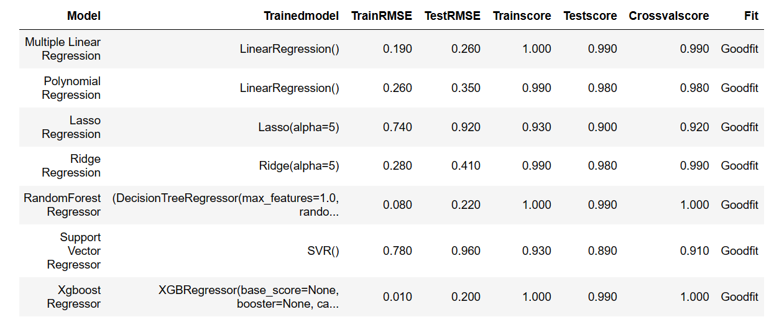
Generating predictions for xtest data
Using predict method in trained model to get ypredictions on test data.
Comparing yprediction values with ytest for loss and performance
For Real Time Predictions, As per algorithms Random forest regression and Xgboost are giving best predictions.
But we choose Random forest regression the actual value is 8.600 and predicted value 8.58.

Slide 14

Questions ??

